Slide 1
COVID-19 Bibliometrics Analysis
Group 12
Chen Yunjin A0091838U
Han Yuxuan A0213738A
Liu Liyao A0198942L
Liu Yuting A0148035J

Slide 2
Content
Overview
Metadata Analysis
Abstract Analysis
Full Text Analysis
Conclusion

Slide 3
Overview

Slide 4
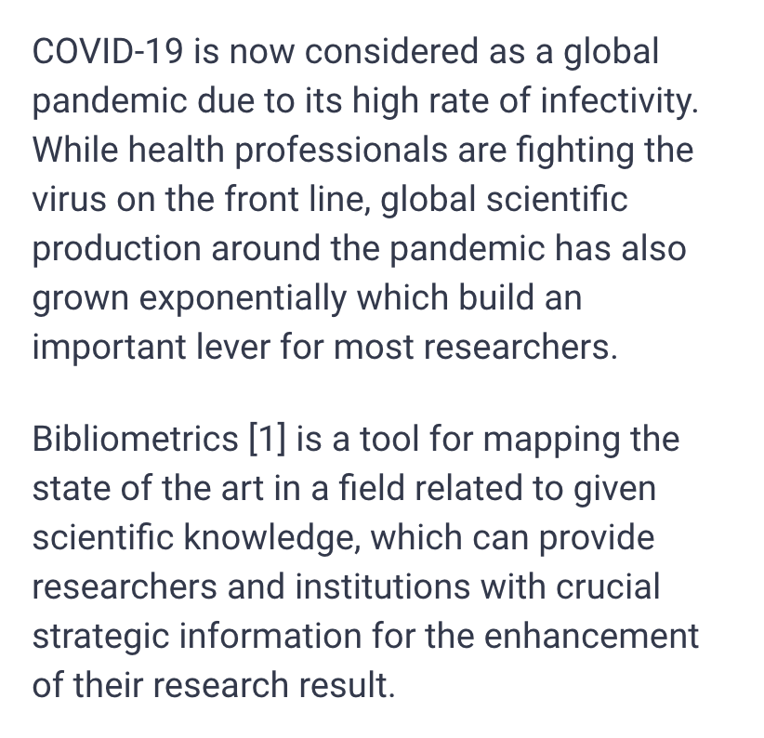
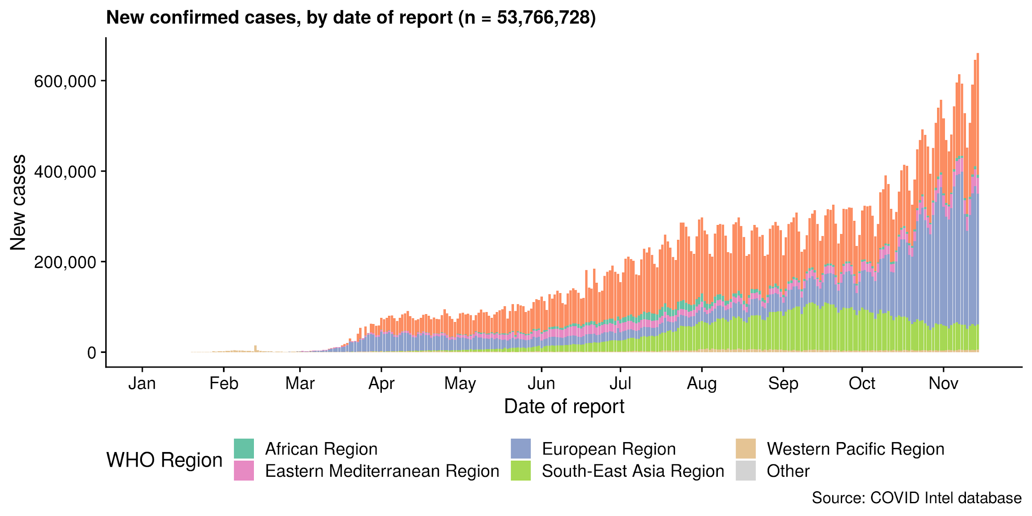
Introduction

Slide 5



Objectives
To measure and compare the scientific output related to the researchers, institutions, and countries.
To perform keyword extraction and clustering on abstract and full text to highlight the hot research fields and trends.
To provide and optimize highly automated bibliometrics analysis methodologies which can be apply to other ‘Big Data’ sets (scientific documents in research fields).
Notes:
https://www.covid19bibliometrics.org/
https://www.researchgate.net/publication/340087851_A_Bibliometric_Analysis_of_COVID-19_Research_Activity_A_Call_for_Increased_Output
https://ebrary.net/18431/education/using_bibliometric_methodology

Slide 6
Data
Volume
6.0GB
CORD19
Variety
280K papers
Cover several public databases
PubMed Central (PMC)
PubMed
World Health Organization’s Covid-19 Database
bioRxiv
medRxiv
arXiv
Key components of each paper
Source
Title
Abstract
Authors
Detail content
(Full Text)
Stored in JSON file
Velocity
0.2 GB daily increment in Last 7 days
Veracity
Missing values, ill-formatted
metadata

Slide 7
Previous Work
 | “Bibliometric method for mapping the state of the art of scientific production in Covid-19” [2] | “A bibliometric analysis of COVID-19 Research Activity: A Call for Increased Output” [3]
Data | Source: SCOPUS , Web of Science Size: 15386 documents from Jan 2020 Others: All types and disciplines available in searching engines, in English, Africa and Arab | Source: PubMed database World Health Organization Size: 564 publications selected from Dec 2019 to Mar 2020
Result | Statistical study to demonstrate scientific contribution by country. Co-author, co-citation maps => institutional groups. Keyword Clouds when searching by different criterias. | Observational studies: disease symptomatology, diagnostic tools efficiency Therapeutic trials: discover novel Treatments and new curative options
Methodology | VOSviewer, a computer program for bibliometric mapping, for example, co-authors and co-citation maps. Wordle, Web-based tool to visualize text to cloud. | Four reviewers looked at the publications + Simple quantitative analysis: # of publications by number of papers.
Pros and Cons | High data variety and veracity, large bibliometric maps. But manual and complex data preprocessing steps. | Convincing insights but not scalable, serve as a good inspiration for our bibliometric analysis direction

Slide 8






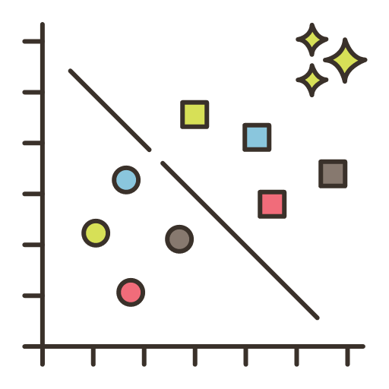
System Overview
Daily updated database on semantic scholar
Download zip file to Azure VM
Extract, transform, and load data to mongoDB
Read data from mongoDB into Pyspark Dataframe. Perform analysis using PySpark
Metadata analysis: Statistical Findings
Abstract analysis: Extraction & Clustering
Full text analysis: Big Data Transformation

Slide 9
System Overview
Daily updated database on semantic scholar
Read data from mongoDB into Pyspark Dataframe. Perform analysis using PySpark
Metadata analysis: Statistical Findings
Abstract analysis: Extraction & Clustering
Full text analysis: Big Data Transformation
Download zip file to Azure VM
Extract, transform, and load data to mongoDB

Slide 10
Metadata Analysis

Slide 11
Workflow
Load Data
spark.read.format("mongo").load()
Transform Data
metadata.select(***).filter(***).agg(***)
To Pandas
df.toPandas()
Visualize
seaborn.barplot(x=x_data, y=y_data)

Slide 12
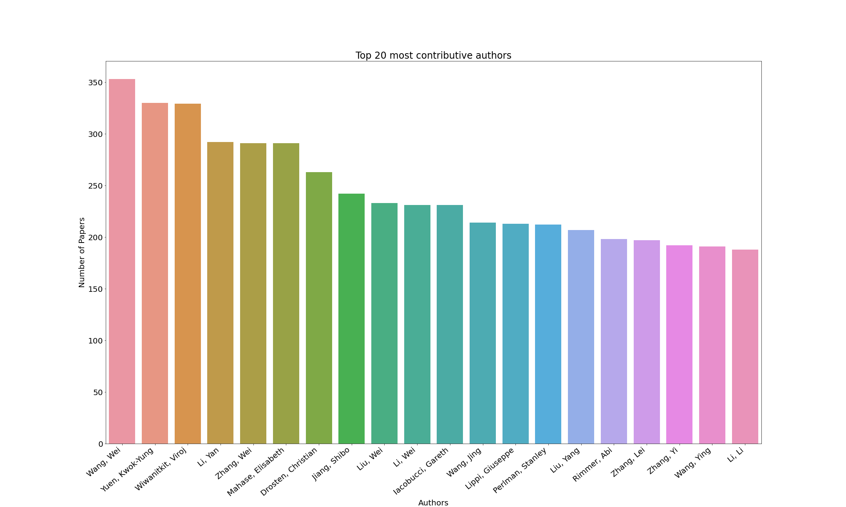
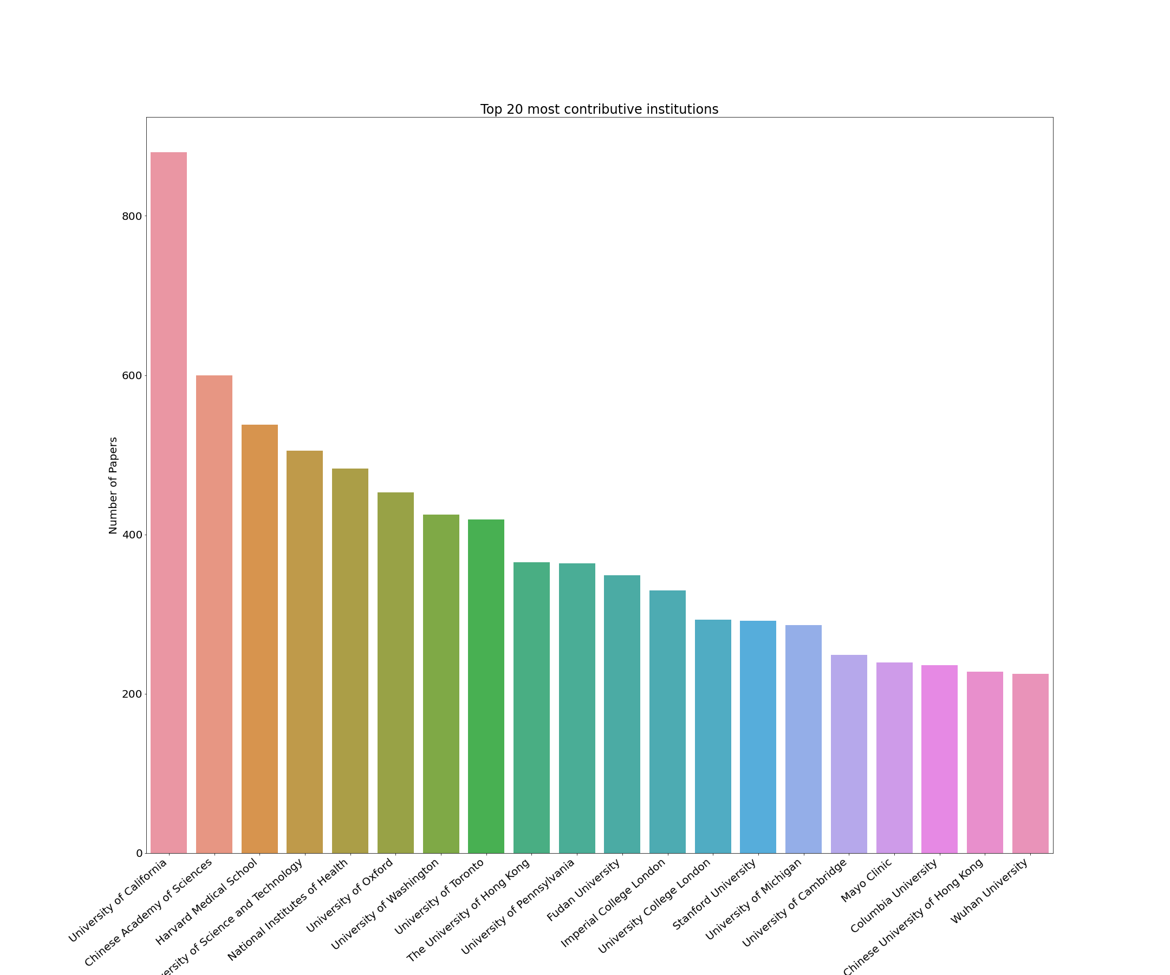
Top Authors & Institutions
Top 20 Contributive Authors
Top 20 Contributive Institutions
Top 3 authors are Wang, Wei, Yuen, Kwok-Yung, and Wiwanitkit, Viroj
Top 3 Institutions are University of California, Chinese Academy of Sciences and Harvard Medical School

Slide 13
Top Journals & Licenses
Top 20 Popular Journals
Top 20 Popular Licenses
Most Popular Journals: bioRxiv, BMJ, PLos One
Most Popular Licenses: no-cc, cc-by, els-covid

Slide 14
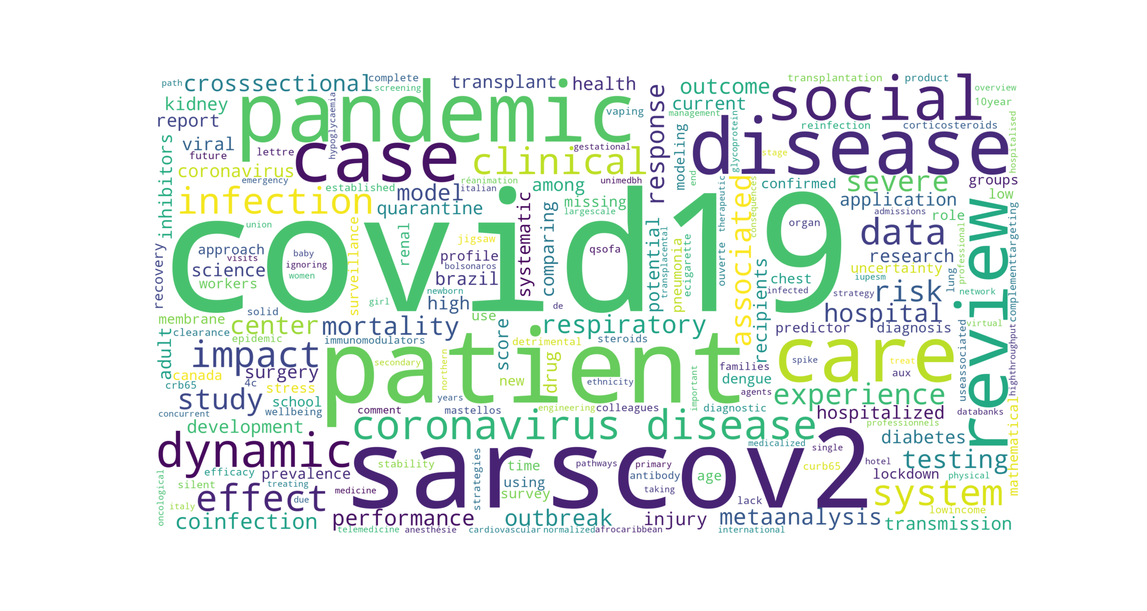
Trending Words
Today’s Big Words

Slide 15
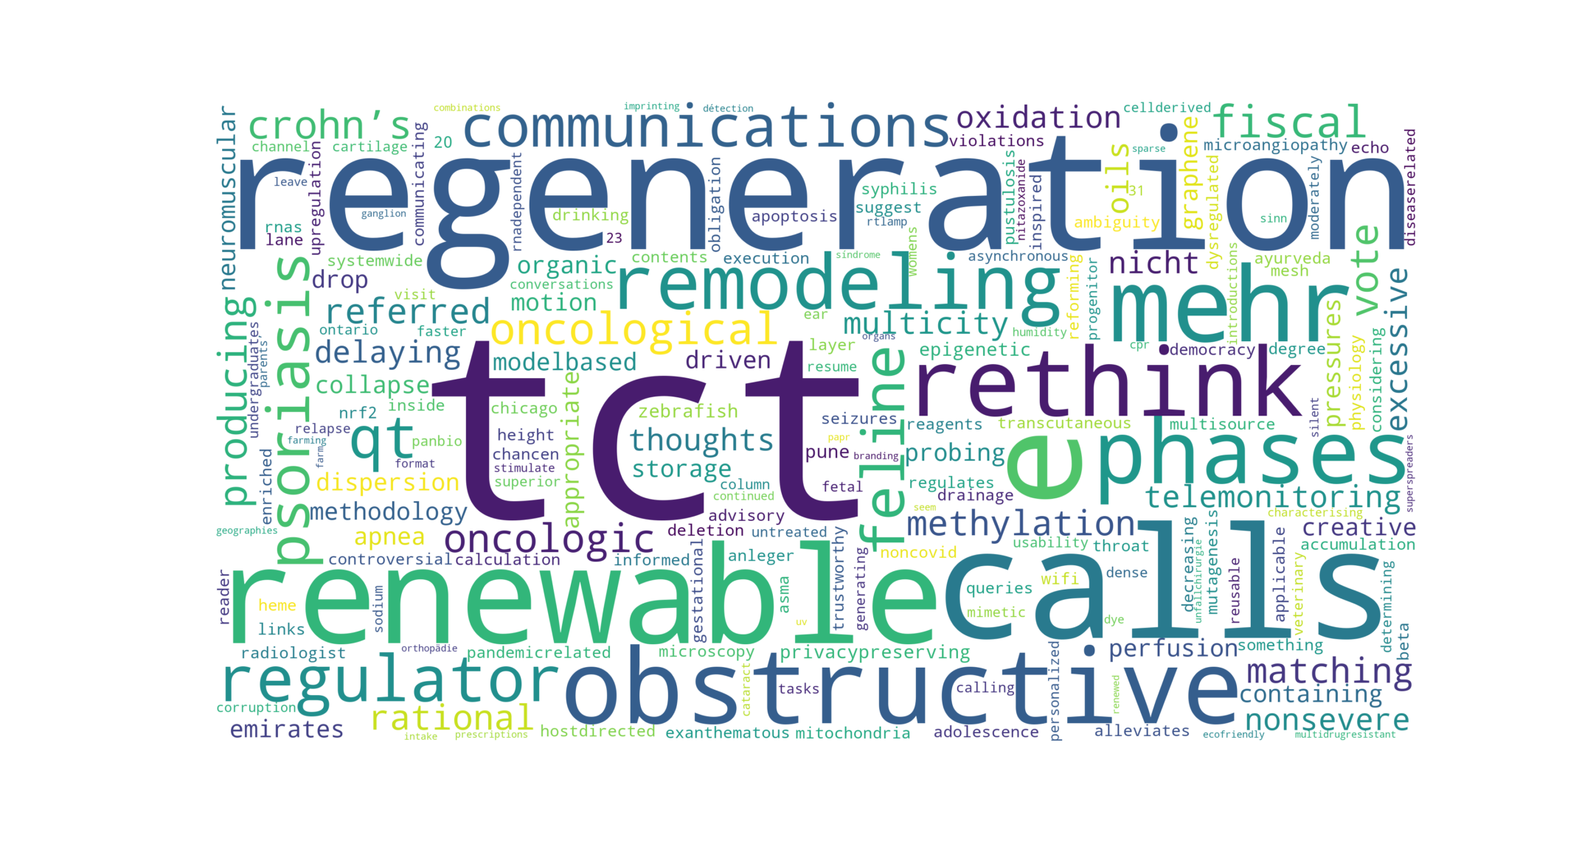
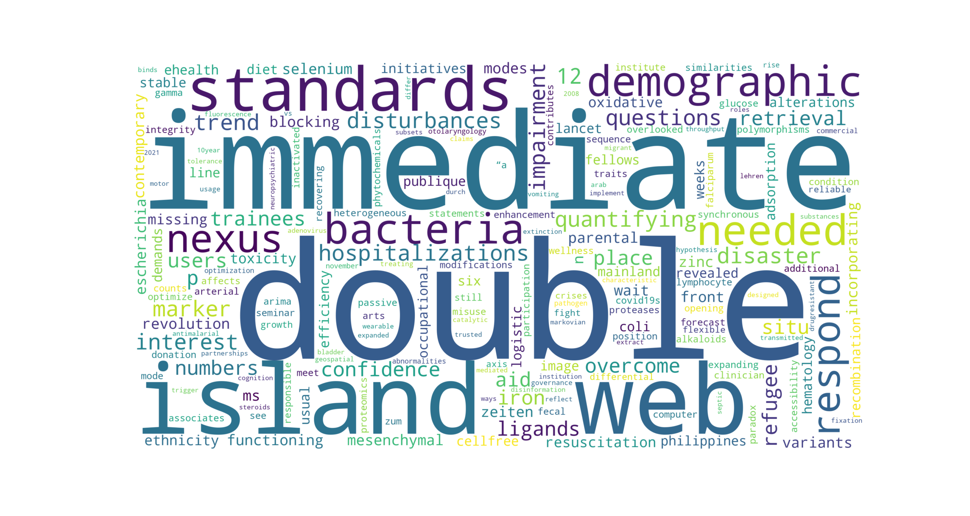
Trending Words - New fields vs Rising stars
New words appeared in recent 2 weeks
Words quickly gain popularity in recent 2 weeks
“TCT” and “regeneration” are the new emerging topics.
An increasing number of papers begin to mention “double” and “immediate”

Slide 16
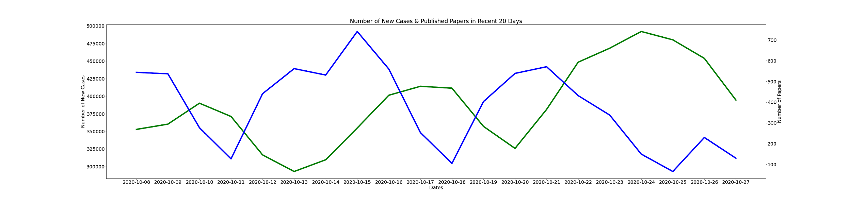
Trends - Research motivations?
Number of New Cases VS Number of Published Papers in recent 20 days
We can clearly see a drag effect between # of new cases and # of published papers.

Slide 17
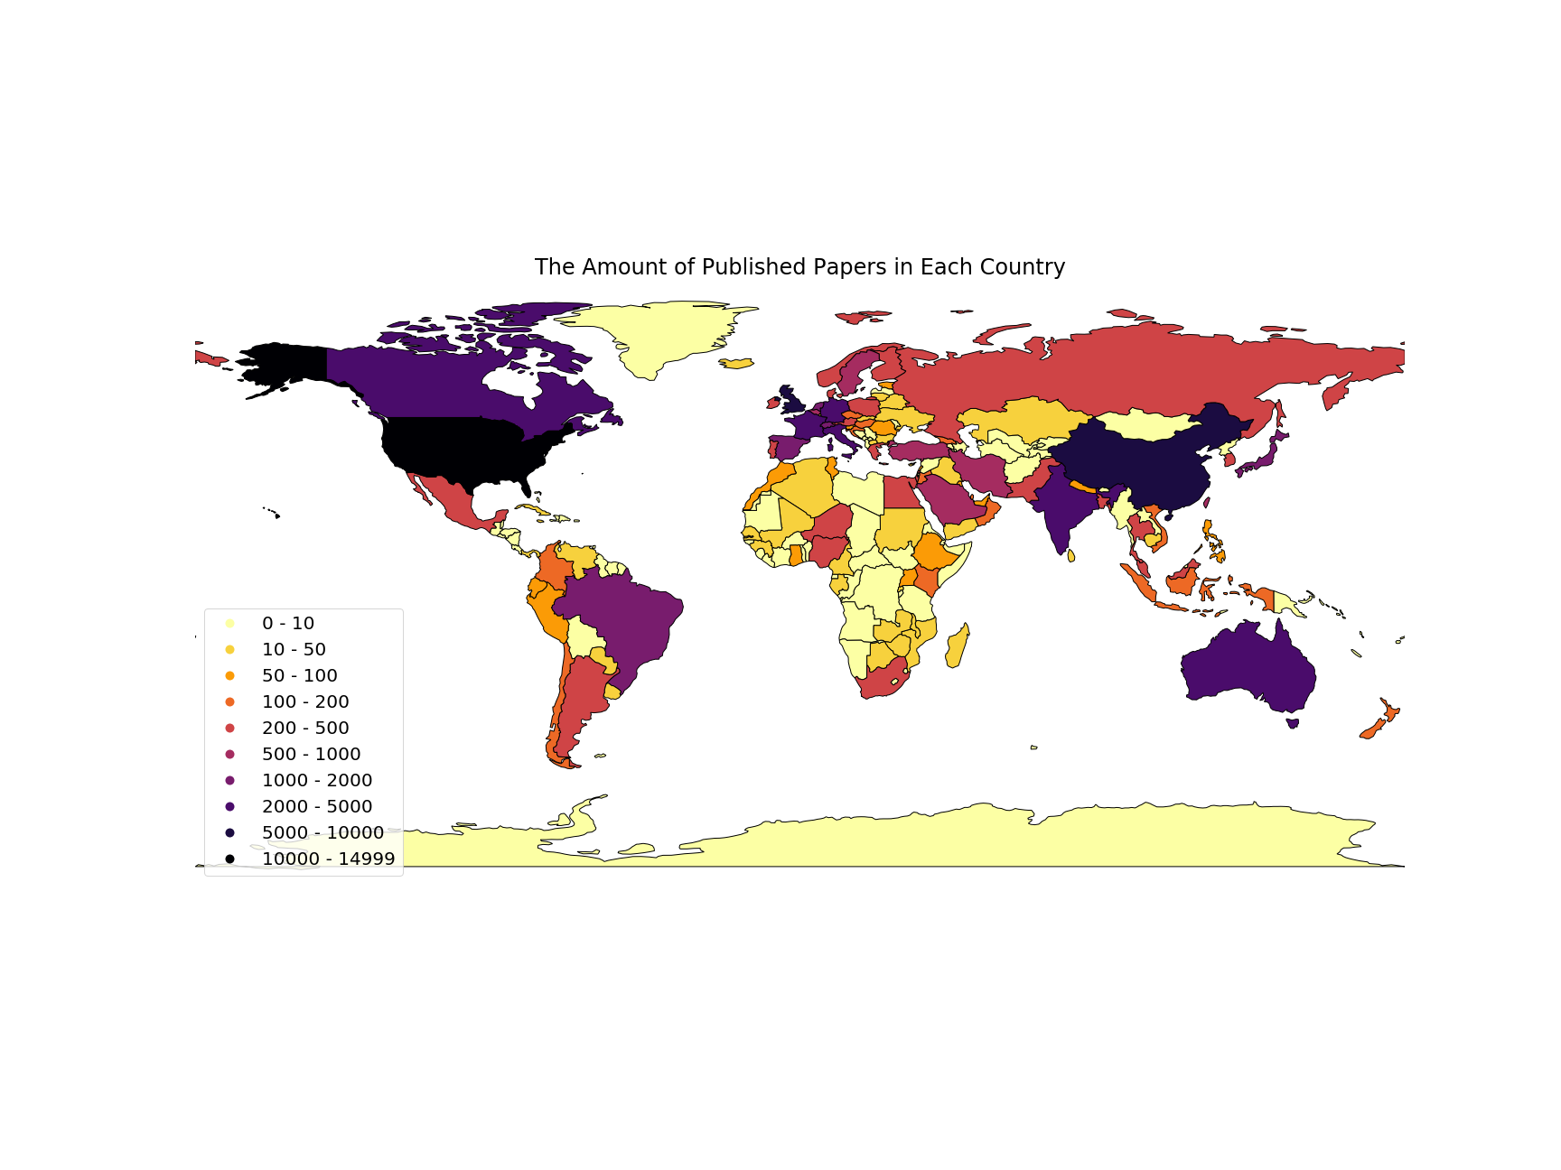
Geo-map - Published Paper Distribution
China and US take the lead, followed by Europe, Canada, India and Australia.

Slide 18
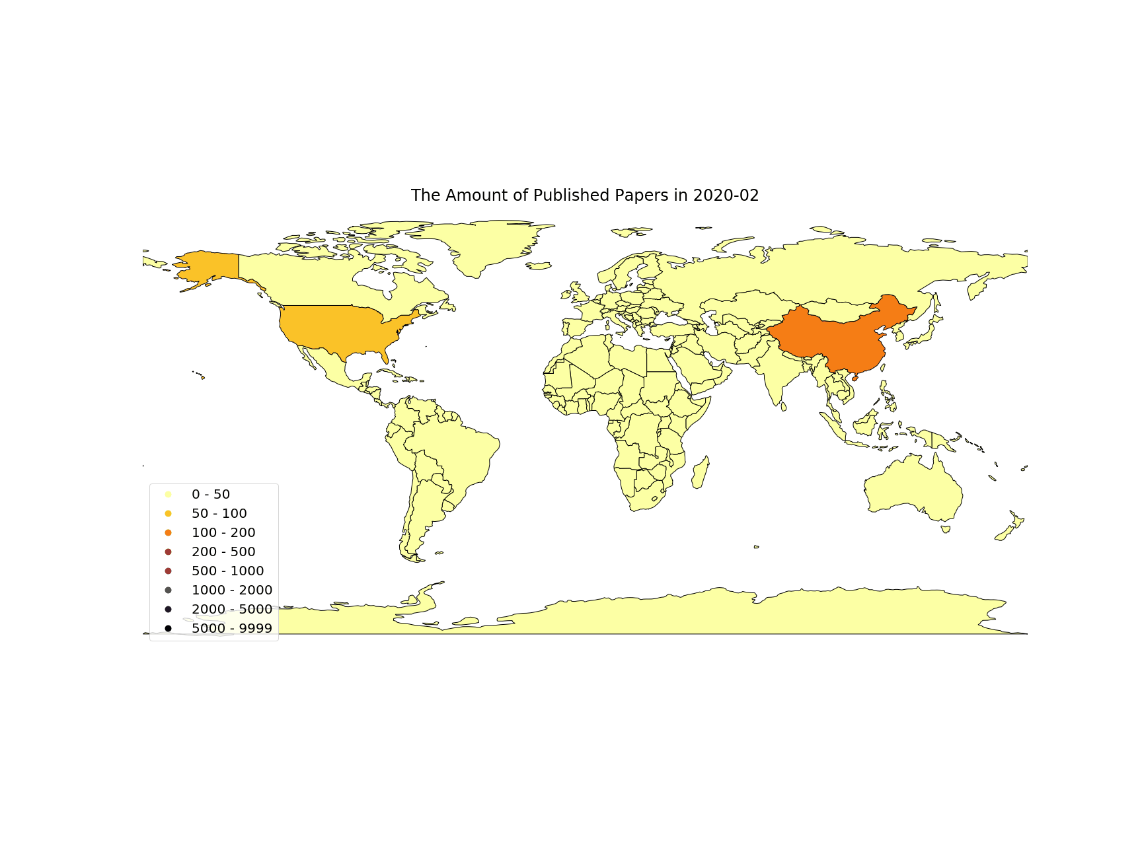
Starting from February, the popularity of research surged and peaked at May. Then it cooled down from June to August, but rebounded again from September.

Slide 19
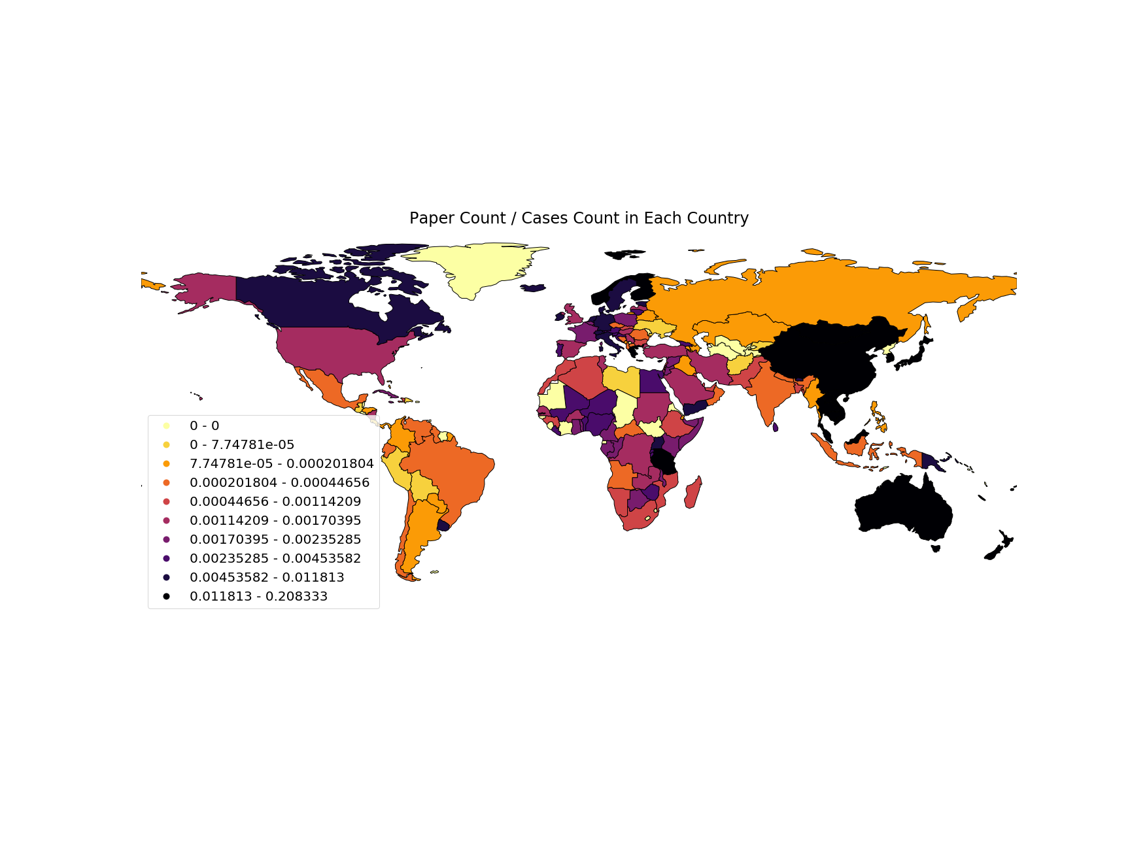
Geo-map - More cases more papers?
China, Japan, Australia, and the Europe are highly responsive to the virus, while India and US are less so.

Slide 20
Abstract Analysis
Notes:
Why Abstract? Abstract summarizes the major aspects of the entire paper, it delivers the key message from the researcher!

Slide 21







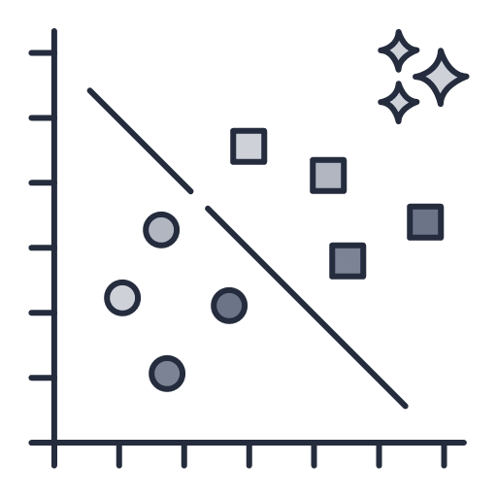
Workflow
Relationship
Ngram
Compare different ngrams
Key Message
Load Data
Remove stopword
TFIDF
Clustering

Slide 22
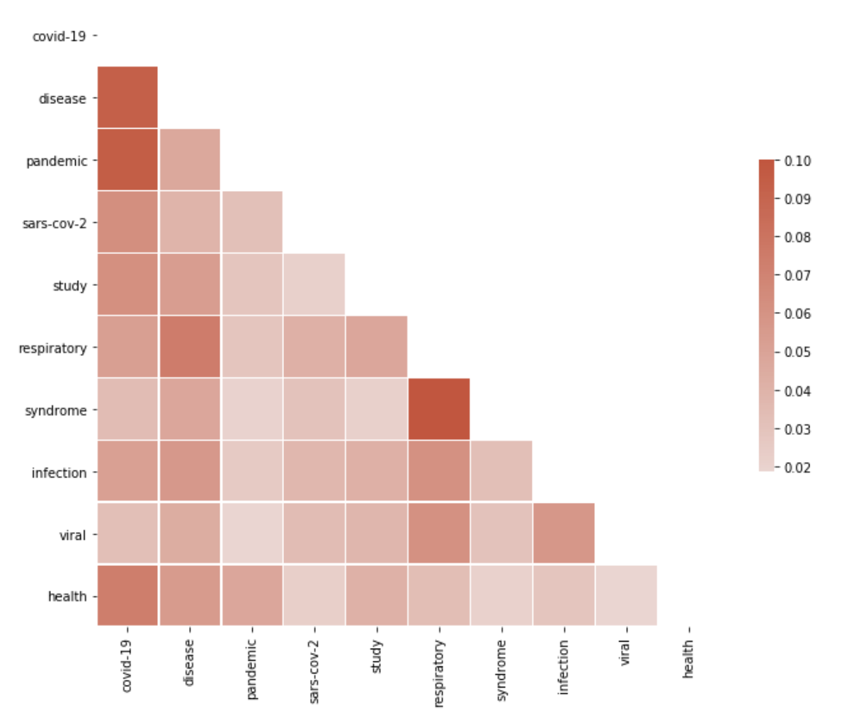
1-gram: relationship analysis for top10 words
"covid-19" have a strong correlation with "disease", "pandemic" or "health"
"respiratory" have a strong correlation with "syndrome" or "disease"

Slide 23
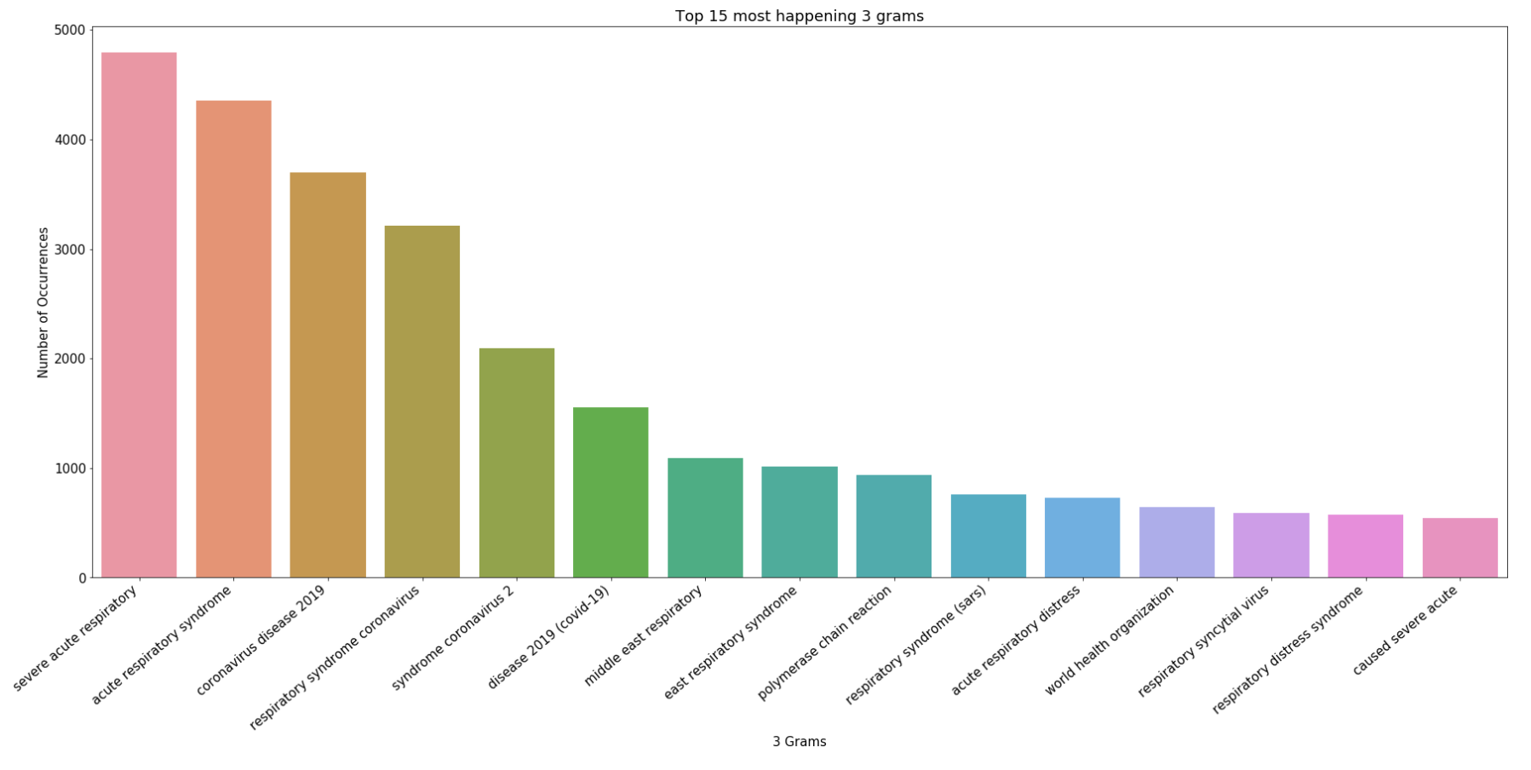
3-gram: Key Messages conveyed
Top 15 messages consist of 3 words

Slide 24
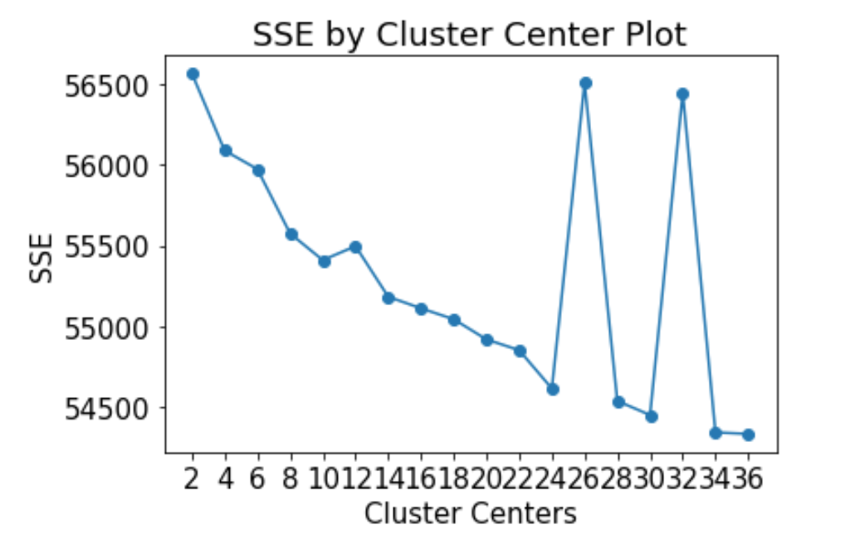
TFIDF Clustering: Parameter tuning
TF-1DF is used -> result in the vector size is 13K+
SSE is used with euclidean meaning to find optimal K.
K=24

Slide 25
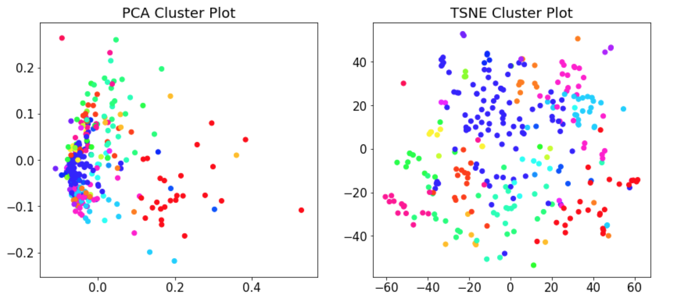
TFIDF Clustering : Visualization

Slide 26
TFIDF Clustering : Result analysis
Cluster No. | Keywords | Findings
0 | mers. respiratory, coronavirus, sars, cov | Coronavirus and sars; both of them are results in respiratory problem.
1 | patients, 19, covid, pandemic, care | Covid 19 -> Pandemic -> Care
2 | sequence, genome, ibv, virus, viruses | Genome sequences related
3 | Wuhan, ncov, disease, coronavirus, 2019 | Wuhan coronavirus 2019
4 | Global, infectious, disease, public, health | Public health topic centric: global diseases & infection
5 | 2009, viruses, virus, h1n1, influenza | Virus related : linked back to h1n1 in 2009

Slide 27
Full Text Analysis

Slide 28
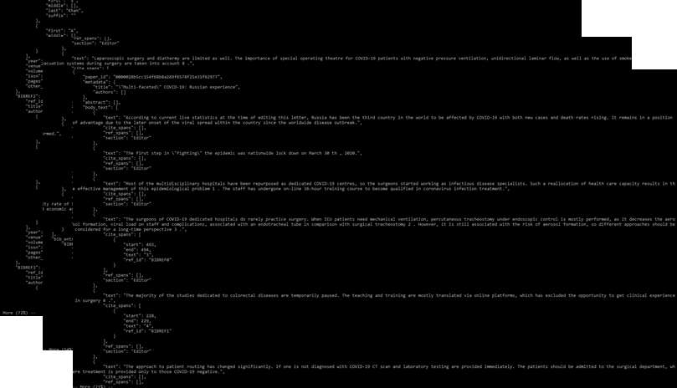
Article data

Slide 29

Workflow
Load Data
Merge back full article
Transform
Stopword
Punctuation
Citation
Link
Short form
etc
Persist
pre-processed data
TFIDF
clustering

Slide 30
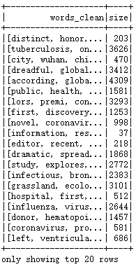
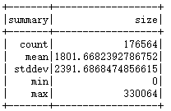

Data transformation

Slide 31
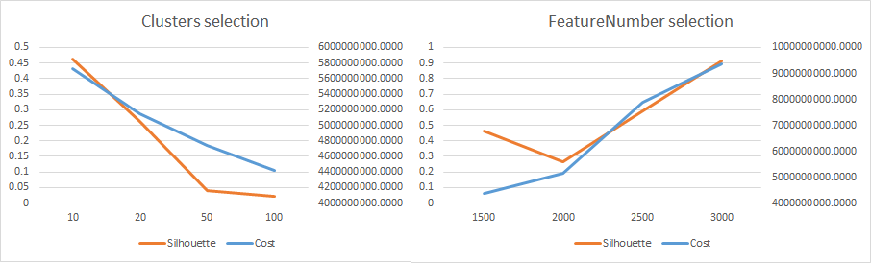
K-Means
Best params:
K=10
Feature=3000
MinDocFeq=5
minDocFreq variation does not lead to much difference

Slide 32
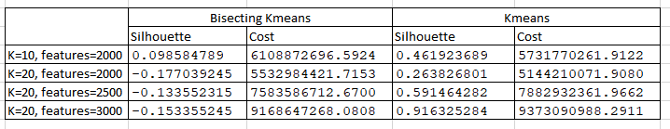
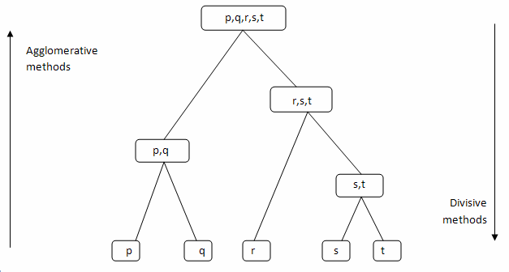
Bisecting K-Means
Bisecting KMeans vs KMeans
Divisive Hierarchical / Top-Down clustering
Divide-and-Conquer
Time/memory efficient (20mins vs 1hr+)
Results…

Slide 33
Conclusion

Slide 34
Limitations & Future Work
Data Collection & Preprocessing
Methodology & Result
Restricted to research papers and preprints and do not incorporate other types of documents, for example, white papers, government publications, etc.
Shortage of foreign language, especially Chinese language papers, which may hinder the potential collaboration and contribution recognition.
No labeled data , which block the supervised learning possibility.
For N-gram in NLP, for a given text, # of unique n-grams can much larger than # of words in the text, which result in longer running time. Besides, it overlooks the sentiment contained.
Results can be hard to interpret with one’s intuitive understanding. Though manual expert intervention can increase the result quality but will break the fully automated manner.

Slide 35
Limitations & Future Work
Data Collection & Preprocessing
Methodology & Result
To increase the data variety by adding multiple data sources, including more document types and including more languages.
To enhance the data storage and preprocessing techniques to support the ‘Big Data’.
To balance the trade off between completeness and efficiency in key messages extractions by comparing different phrases extraction models (e.g., skip-grams from Spacy).
To include sentiment analysis on big data from multiple sources (e.g. social media or news) to understand the impact of scientific research from a broader perspective.

Slide 36



Summary
This project has presented methods to aid researchers in understanding the COVID-19 publications landscape by applying quantitative analysis, keywords extraction, document embedding and clustering on COVID-19 ‘Big Data’.
Besides, our methodologies are also applicable to other fields of research, especially epidemic, treatment or other scientific topic with lasting global impact.
In the final report, we will elaborate more on the model selection and parameter tuning for our keywords extraction and clustering. Also, we will explore more on the unsupervised document embedding techniques to achieve better clustering results.

Slide 37
Thanks

Slide 38
References
[1] Sengupta IN . Bibliometrics, informetrics, scientometrics and librametrics: an overview. Libri 2009;42(2):75–98 .
[2]Mohamed El Mohadab, Belaid Bouikhalene , Said Safi. Bibliometric method for mapping the state of the art of scientific production in Covid-19 (Jun, 2020).
[3] Chahrour M, Assi S, Bejjani M, et al. (March 21, 2020) A Bibliometric Analysis of COVID-19 Research
Activity: A Call for Increased Output. Cureus 12(3): e7357. DOI 10.7759/cureus.7357
[4] Matplotlib: https://matplotlib.org/contents.html
[5] Seaborn API Reference: https://seaborn.pydata.org/api.html
[6] Wordcloud: https://pypi.org/project/wordcloud/
[7] Geoplot: https://residentmario.github.io/geoplot/index.html
[8] Country-converter: https://pypi.org/project/country-converter/

